Slide 1
Planned Obsolescence and Quality Education
David M. Boje 9/30/2018

Slide 2
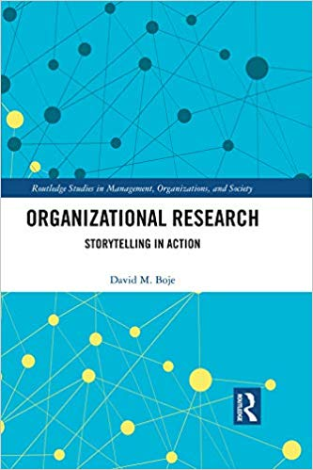
My new book
Amazon
It is a storytelling research method: e.g. to understand the Existential Crisis New Mexico faces as its oil & gas severance taxes cannot pay for K-12 & Higher Education, and we stay stuck in a 3% State model to finance Higher Ed (less & less) while students tuition go up & up, and textbooks are more & more expensive with all the planned obsolescence.

Slide 3
Once Upon a Time
A car would last decades
I could fix it with a few tools
I could repair the TV or Washing Machine by going to the Tech Center at Sears
A textbook would be good for many years
Higher Education in a State University was almost free, but now its not that way anymore

Slide 4
Once Upon a Time
Quality Education was ‘built to last’, but now your textbooks, are built to be replaced in a year or two, with the new edition.
But little changes, pages moved around, a paragraph here and there is shorter or longer
The test bank questions are shuffled, or some questions for 3 editions ago are brought back
NMSU could Require textbooks with LONGER LIFE SPAN

Slide 5
New Mexico’s Gas & Oil severance tax financing of Quality (?) Education
NMSU to be run like a business says new Chancellor Arvizu (source).
The State of NM (governor) appoints the Board of Regents (or approves the student member), who invest in Athletic Programs that lose money, but raise tuition for students, and hire Deloitte consultants paid $622,000, and now face $3 million deficit
The reduce-reuse-recycling (4 bin system) is not a priority, because it’s not making the NMSU business enough money, yet NMSU has a Gold Star in Sustainability, and touts its recycling as exemplary.

Slide 6
Migration for Market Economy to Market Society
Michael Sandel, points out how speculative financing (e.g. gas & oil future revenues; sports betting) is playing casino financing of the Market Society. YouTube & YouTube Future of Capitalism when Market Society (& speculative Casino financing) seeps into every part of society, including education
A University is not a business, it is a way to create knowledgeable citizens. NMSU education needs to be offered free to New Mexicans, and hardly much more to all
Public University running for profit is an bad idea

Slide 7
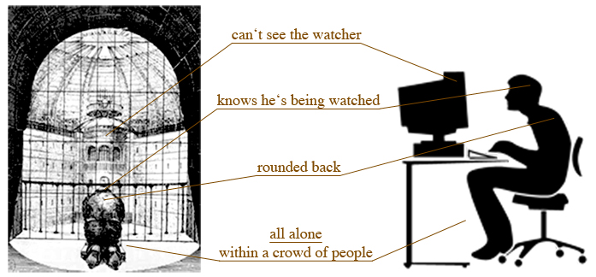
Is multiple choice testing quality education?
In the factory model of Higher Education, its all about the panopticon of surveillance

Slide 8
Definition
Planned obsolescence is the BUSINESS STRATEGY purposeful planning and design of limiting useful life span of a product, design, or operating system to a schedule, in order to induce consumers will throw them away quicker, and not repair them, and just replace them
There is ‘material obsolescence’ (by engineering so impossible to repair) and ‘perceived obsolesce’ (by marketing the new color or style)
The opposite of planned obsolescence is ‘Built to Last’, which inventors & businesses did do, a century ago

Slide 9
Ironic history of plastic
Plastic industry began with organic (non-fossil fuel) plastic called cellulose in order to save the whales
Plastic became a waste-product of coal, oil, and gas production

Slide 10
Planned Obsolescence History
1901 – Centennial Light bulb (invented by Adolphe A. Chaillet) installed in US firehouse, still burning (See webcam) – industry standard by 1924 is blubs last 2,500 hours or more
1922 Alfred P. Sloan, Jr., the MIT-trained genius behind General Motors, to expand auto sales and maximize profits by eliminating streetcars. In 1922, according to GM's own files, Sloan established a special unit within the corporation which was charged, among other things, with the task of replacing America's electric railways with cars, trucks and buses.
1923 Alfred P Sloan develops ‘perceived’ planned obsolescence strategy (style & color changes each year) to overtake Henry Ford’s Model T (same color, same style every year)
1924 Phoebus cartel set up to limit life span of incandescent bulb to no more than 1,000 hours – See Light Bulb Conspiracy – YouTube extended version
1928 Printer’s Ink magazine warning against quality: “An article that refuses to wear out is a tragedy of business”
1932 Bernard London writes “Ending the Depression through Planned Obsolescence” (see copy)
1932 GM streetcar conspiracy - monopolizing the sale of buses and supplies to National City Lines (NCL) and its subsidiaries, and to allegations that this was part of a deliberate plot to purchase and dismantle streetcar systems in many cities
1940s DuPont invents synthetic fiber (nylon) stocking that lasts forever, so DuPont told engineers ‘go back to drawing board, come up with more fragile stocking that would run, not last as long.’ (see Alec Guinness 1951 tries to invent long chain polymer in The Man in the White Suit)
1960 Vance Packard’s expose ‘The Wastemakers (get PDF)’
1970 Textbook publishers for universities have every 2-3 year edition changes to enact planned obsolescence (cannot reuse last edition) resulting in more student debt; reshuffle content with few real changes in substance year to year
1975 Bic’s Plastic razors displace life-long stainless steel razor by using planned obsolescence (disposable)
1986 Fiji Film’s’ Quicksnap’ single use disposable camera
2001 Apple iPod planned obsolescence (300 charges limit or 18 months) and sells no replacement battery, just ‘buy new one’
2007 Inkjet printers have planned obsolescence chip with limit on number of copies, then message: "Parts inside the printer have reached the end of their service life” when they hadn’t; or “Replace ink cartridge” (but 20% remains)
2008 MacBook Air (RAM inaccessible for upgrade)
2009 E-waste of 1st world to underground village child labor in Ghana, China, India and so on See YouTube
2013 HTC One smartphone difficult to open for repair without damaging case
Notes:
Timeline YouTube https://www.youtube.com/watch?v=nW8bKrJ72x4

Slide 11
Can NMSU have less Planned Obsolescence?
Textbook publishers for universities have every 2-3 year edition changes to enact planned obsolescence (cannot reuse last edition) resulting in more student debt; reshuffle content with few real changes in substance year to year
Quality Education can mean NO MORE PLANNED TEXTBOOK OBSOLESCENCE

Slide 12
History of Planned Obsolescence
1924 Phoebus Cartel formed to limit life span of incandescent bulb to 1,000 hours Timeline YouTube
1920s Alfred P. Sloan of GM, saw planned obsolescence as a way to gain strategic advantage over Henry Ford’s Model T (comes in one style and one color)
How did Sloan do it? By introducing new color and style changes each year
1932 Bernard London wrote a paper “Ending the Depression through Planned Obsolescence”
➔ federal government print expiration dates on otherwise durable goods to urge purchasing. “Furniture and clothing and other commodities should have a span of life, just as humans have”… “They should be retired, and replaced by fresh merchandise. It should be the duty of the State as the regulator of business to see that the system functions smoothly.”
1954 Brooks Stevens told advertising conference: “Instill in the buyer,” “the desire to own something a little newer, a little better, a little sooner than is necessary.”
1960 Vance Packard’s book THE WASTEMAKER (people buy more than they need and cause harm)
1973 Oil crisis say government raising emissions standards; consumers stopped buying next year’s GM/Ford/Chrysler model’s (planned obsolescence) color & style trip package and got more practical ➔bought functional compact cars from Asia
2007 Apple begins to sell iPhone (now has sold one billion) and does it by planned obsolescence (18 to 24 month turnover by making battery price almost cost of new phone)
Notes:
Sources: https://timeline.com/gm-invented-planned-obsolescence-cc19f207e842
https://www.youtube.com/watch?v=nW8bKrJ72x4

Slide 13
https://www.cnet.com/news/your-smartphones-secret-afterlife-smartphones-unlocked/
What happens to the Cell Phones, Computers, & Printers you donate or turn over to recycling?

Slide 14
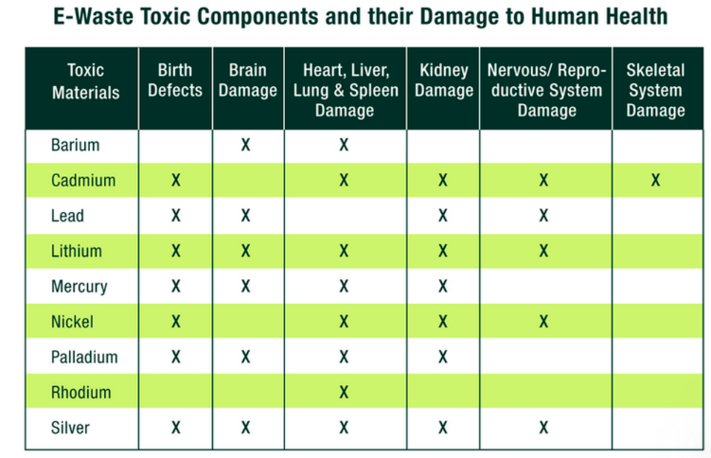
https://www.cnet.com/news/your-smartphones-secret-afterlife-smartphones-unlocked/

Slide 15
What happens to NMSU E-Waste?
Electronic waste is a huge problem around the globe. The worst-case scenario is that electronic trash winds up in unregulated or mismanaged heaps, slowly leaking corrosive chemicals into the soil and water table.
U.S. generates upwards of 2.37 million tons of electronic waste materials each year, according to an EPA 2009 report.
US turns over 130 million cell phones each year

Slide 16
Plastic and Quality Education
Plastic comes from the Greek verb plassein, which means "to mold or shape."
How does use of Plastic in Planned Obsolescence shape and mold education?
Short Answer: The hidden curriculum of plastic education without regard to the health, poverty, and justice consequences for the world.

Slide 17
Plastic History
1534 Marco Polo encounters early version of Shellac in Orient made by beetles in Lac Tree; 1856 Shellac - Invented by Alfred Critchlow and Samuel Peck;; 1876 Henry Perkin perfects a way to turn coal tar into shellac & by WWI polyurethane lacquers emerge;After WWI the Beatle-production-method gives way to Polyurethane chemistry
1839 - Polystyrene or PS discovered by Eduard Simon; made practical in 1938 by Ray McIntire, working for Dow Chemicals, invented Styrofoam (polystyrene foam)
1863 Billiard ball manufacturer offered $10,000 to anyone inventing alternative to ivory for making billiard balls
1867 NYT warned elephants going extinct due to insatiable Victorian age demand for ivory, mostly for making billiard balls.
1869 John Wesley Hyatt invented plastic cellulose from cotton fiber (Source)
“It lacked the bounce and resilience of ivory, and it was highly volatile. The first balls Hyatt made produced a loud crack, like a shotgun blast, when they knocked into each other. One Colorado saloonkeeper wrote Hyatt that "he didn't mind, but every time the balls collided, every man in the room pulled a gun”; not great for billiard balls, but useful for combs and making celluloid film; DuPont bought one of the original cellulose plastic companies

Slide 18
Plastic History Continued
1872 PVC (Polyvinyl chloride) invented by Eugene Baumann, but he did not apply for patent, and it was pretty useless until 1926 when Waldo Lonsbury Semon, working for the B.F. Goodrich Company in the United States as a researcher, when he invented plasticized polyvinyl chloride, and golf balls and heels on shoes were made
1907 Leo Bakelite invented first synthetic fossil fuel plastic to replace shellac. He used formaldehyde with phenol, a waste product of coal. The Bakelite combs, phones, radio consoles were made by baking the chemicals in a mold.
1933 R.O Gibson and E.W. Fawcetts, working for the Imperial Chemical Industries Research Lab, accidentally created a white, waxy substance called, Polyethylene. Used in WWII to insulate underwater cable and radar
1935, Wallace Carothers, working for DuPont, invented Nylon, and tragically committed suicide 1937. DuPont advertised nylon ‘as strong as steel’ and it was too strong, and DuPont sent chemists back to the drawing board to make it fragile so stocking would run. Planned Obsolesce was the DuPont strategy
1938 - Polytetrafluoroethylene or PTFE tradenamed Teflon - Invented by Roy Plunkett
1941 - Polyethylene Terephthalate or PET - Invented by Whinfield and Dickson
1950s – Plastic Mass production expands to 1.7million tons per year globally & increases exponentially
1951 - High-density polyethylene or HDPE trade named Marlex - Invented by Paul Hogan and Robert Banks
1953 Karl Ziegler of the Kaiser Wilhelm Institute and Erhard Holzkamp invented HDPE (High Density Polyethylene)
2014 – plastic production 211 million tons per year, globally
2050 – plastic production expected 2000 million tons per year, globally

Slide 19
Plastic Codes and Education
#1 PET Polyethylene Terephthalate ➔ Some hazard: leaches Antimony metallic toxin when heated, BUT ALL PLASTICS absorb solvents & other toxins during manufacturing, which leach throughout their life cycle; US government (& EPA, & USDA) maintain chemicals in plastics (except #7 BPA in baby bottles) are safe (Beware!)
#2 HDPE High Density Polyethylene used in milk & juice containers, cosmetic & shampoo containers, cereal box liners ➔ Some hazard: produces estrogenic activity altering human cells
#3 PVC Polyvinyl Chloride used in shrink wrap, meat warp, toys, deodorant, raincoats ➔ high hazard: contains softener additive DEHP phthalates that cause asthma, enter blood stream, affect immune system & in males reproductive health. The DiNP substitute for DEHP has same health hazards
#4 LDPE Low Density Polyethylene used for dry cleaning bags, frozen food wraps, produce bags, paper milk cartons, hot & cold drinks, toys, squeezable bottles ➔low hazard

Slide 20
Plastic Codes and Education
#5 PP Polypropylene used for yogurt, ketchup & margarine containers ➔ moderately safe except when microwaved
#6 PS Polystyrene (AKA Styrofoam) used for hot & cold drink cups, plates, container for baked goods ➔ High Risk, styrene linked to cancer (Leukemia),stomach issues; takes 100 years to decompose; leaches faster when heated
#7 OTHER (mostly Bisphenol A, aka BPA) used in reusable water bottles, coffee makers, some ketchup bottles, etc. ➔ High Risk cancer, endocrine problems, type 2 diabetes, early onset puberty; leaches at room temp BPA banned in US for baby bottles, but USDA claims its safe for all other uses; BPA is banned in EU & Canada; Bisphenol-S (BPS) legal substitute, but has same endergonic disruption; CDC finds 92.6% of Americans have PBA toxins in their bodies

Slide 21
Why NMSU?
Why is Styrofoam sold by food vendors on NMSU campus?
#6 PS Polystyrene (AKA Styrofoam) used for hot & cold drink cups, plates, container for baked goods ➔ High Risk, styrene linked to cancer (Leukemia),stomach issues; takes 100 years to decompose; leaches faster when heated
Why is Reduce all kinds of Plastic in food and beverage containers, at NMSU not a strategic top priority?
Why is plastic in mixed use E-waste not a strategic top priority? Where does NMSU E-waste go?

Slide 22
Science Experimental Studies Find
PE, PP, PS, PVC, and HDPE left 24 hours in sea water, all but PVC had leached identifiable toxic additives and toxics absorbed in production processes such as solvents
2nd study 57 to 78 days of LDPE, PET, PS, BPA & PVC in sea water found cumulative effects of emissions of oligmers & additives, including oligomers released from the print on PET bags, with PFC having highest leaching potential of toxic chemicals, heavy metals, pesticides absorbed,, PCBs (polychlorinated biphenyls) that enter animal & marine life (61% considered priority pollutants by U, & 79% by EPA, which ironically claims US plastic safe)

Slide 23
Nanoplastic Chemical Cocktail
All macro- & nano-scale plastic absorb and leach hazardous substances during polymerization-manufacturing & in distribution & disposal plastic life cycle. Polymer chains fragment into monomers (or small oligomers), and macro-scale plastic becomes microplastic (size of grain of sand) and fragments to infinitesimal nanoplastic particles too tiny to see, light enough to float in the air, entering all spaces of the environment, penetrating marine, animal, plant, and human bodies to their very core.
Impact of plastic absorbing & then leaching, in combining various chemicals, additive, using solvents, absorbing PCBs, and all sorts of hazardous chemicals, results in toxic chemical cocktails
Nanoplastic cocktails migrate across the global spatial surface, and have impact into depth of water, soil, and biota and human bodies

Slide 24
Boje’s 12 Leadership Asks:
Ask state of NM to stop the senseless 3% growth funding formula for Higher Ed
US, be the final developed country to ratify the Basel Agreement to stop sending E-waste to developing countries, with no way to process it
NMSU stop the textbook planned obsolescence
Ban the plastic that is toxic
Ban single-use plastic bottles and food ware at NMSU
Issue a safe coffee mug and drink bottle
Get the Styrofoam out of Frenger
Stop using single-use plastic water bottles for all NMSU functions
Get an updated recycling sorting system that includes composting, and has an e-waste bin
Stop contracting with all vendors who have e-waste
Make quality education and not lowest funding the priority of State of New Mexico.
Stop Running Higher Education like a business

Slide 25
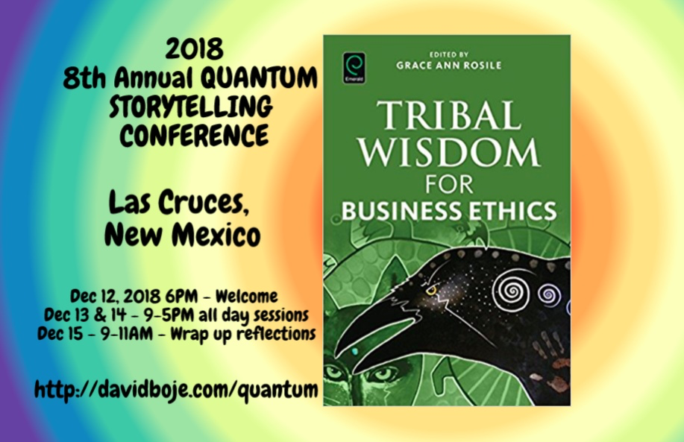
You are Invited to STORYTELLING CONFERENCE in December

